Slide 1
Mask RCNN
Computer Vision

Slide 2
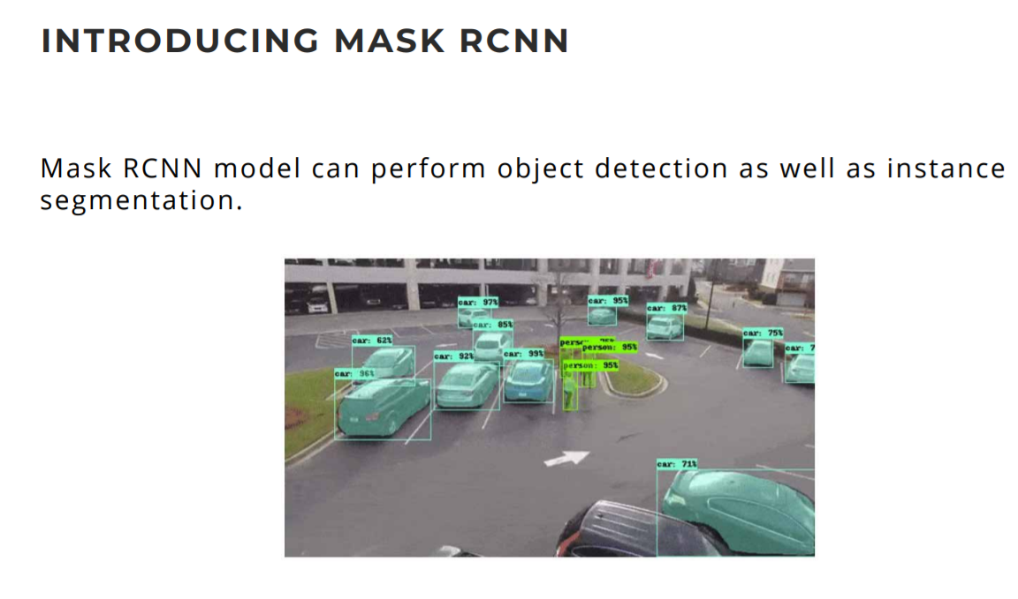
Introduction

Slide 3
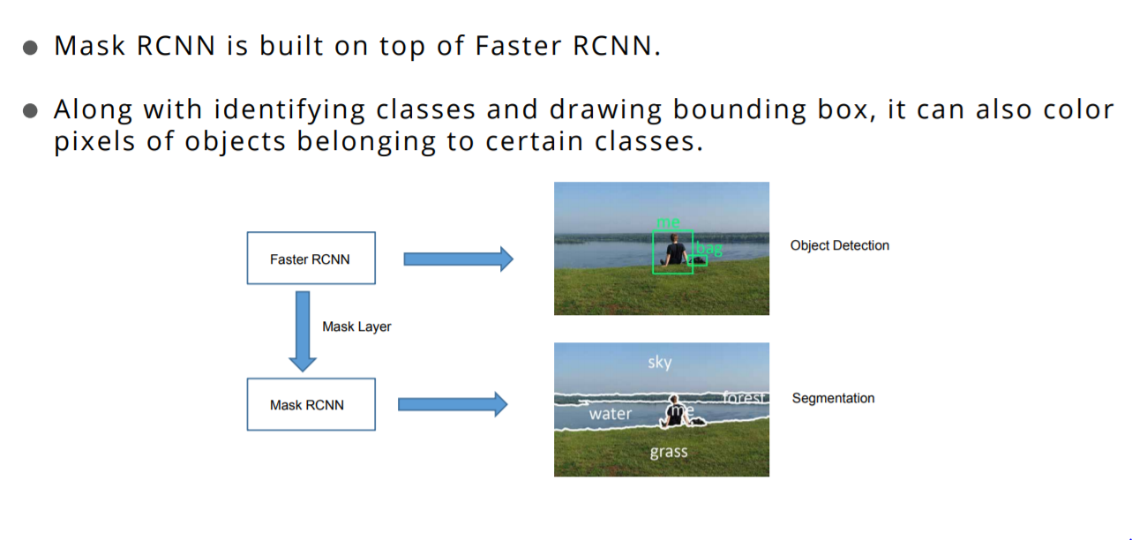
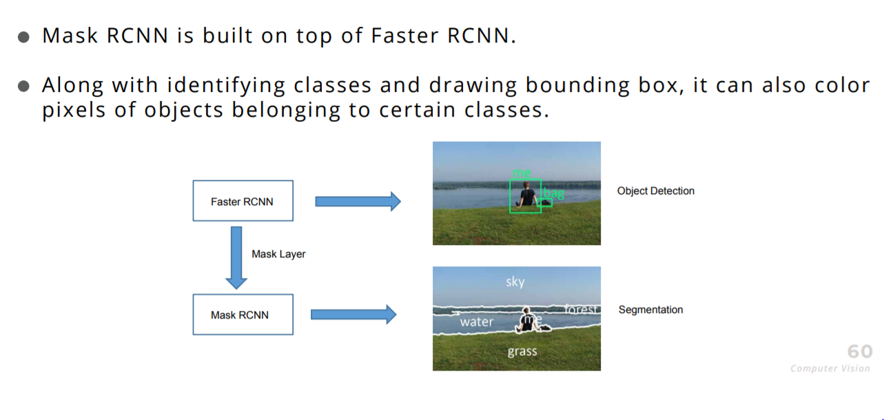
HOW DOES IT WORK?

Slide 4
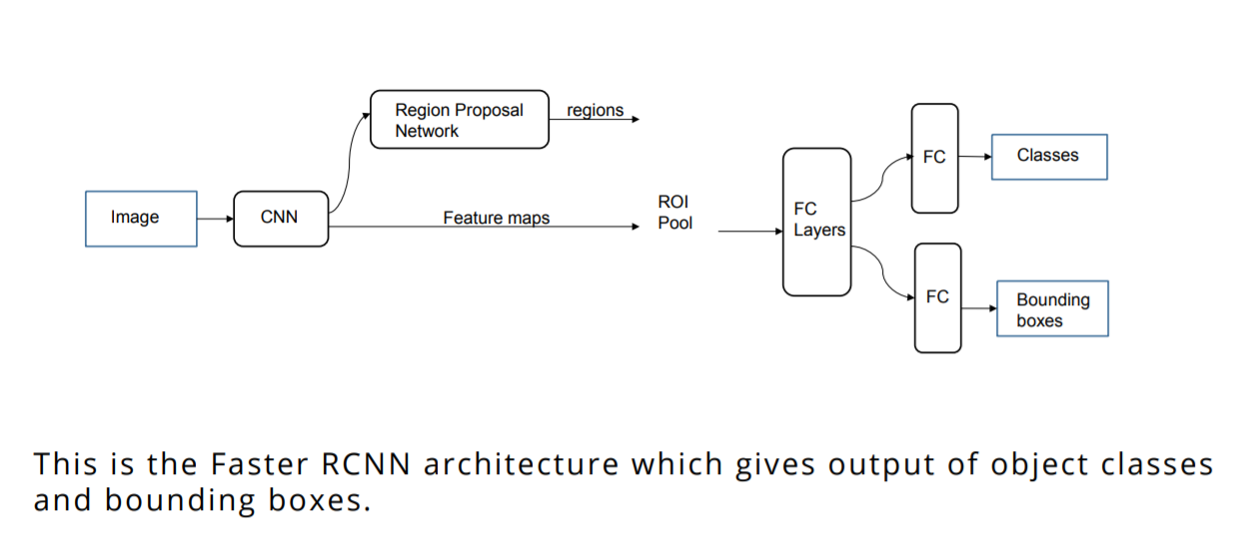
REVISITING FASTER RCNN

Slide 5
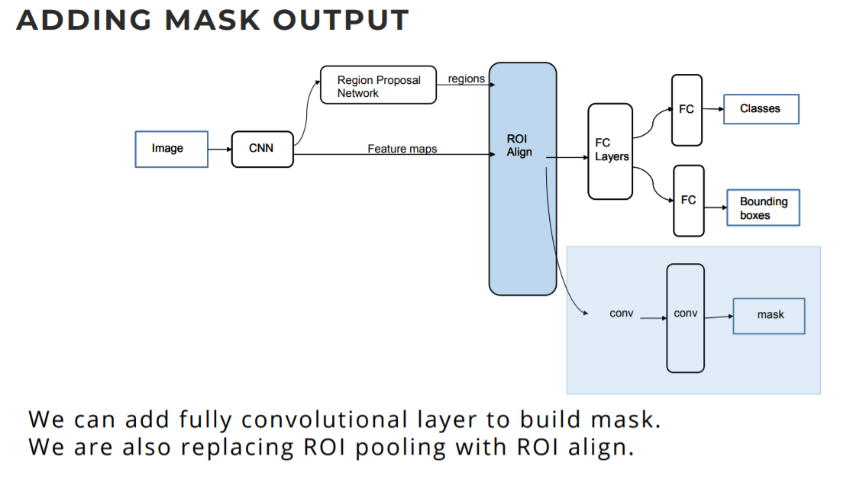
Mask Output

Slide 6
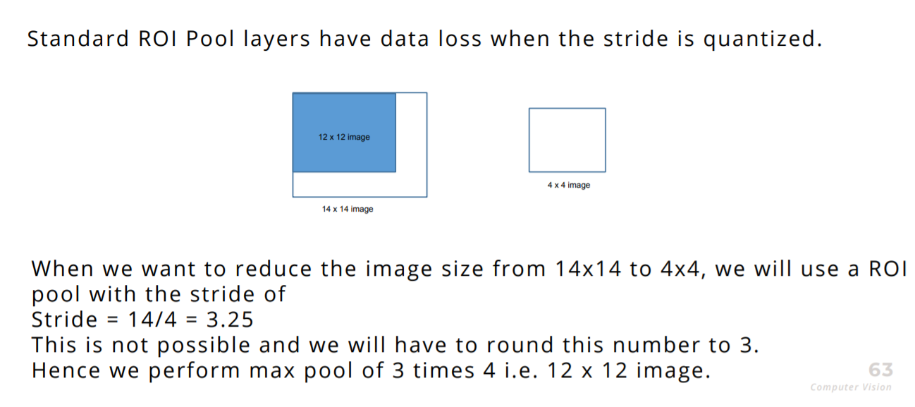
PROBLEMS WITH ROI POOL

Slide 7
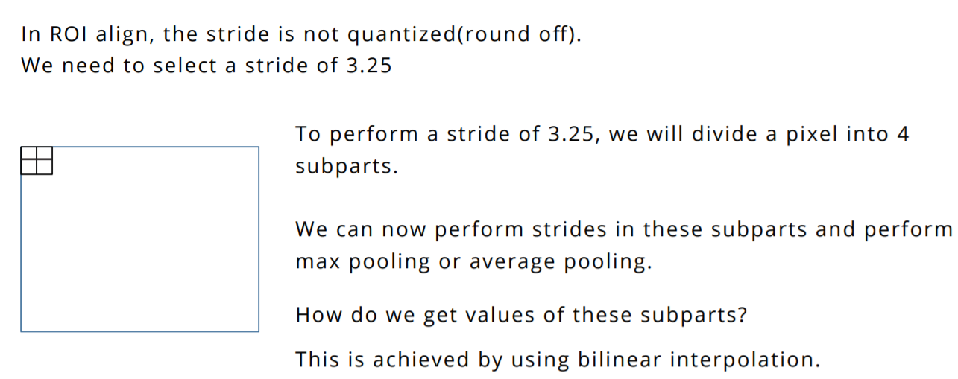
WHAT IS ROI ALIGN?

Slide 8
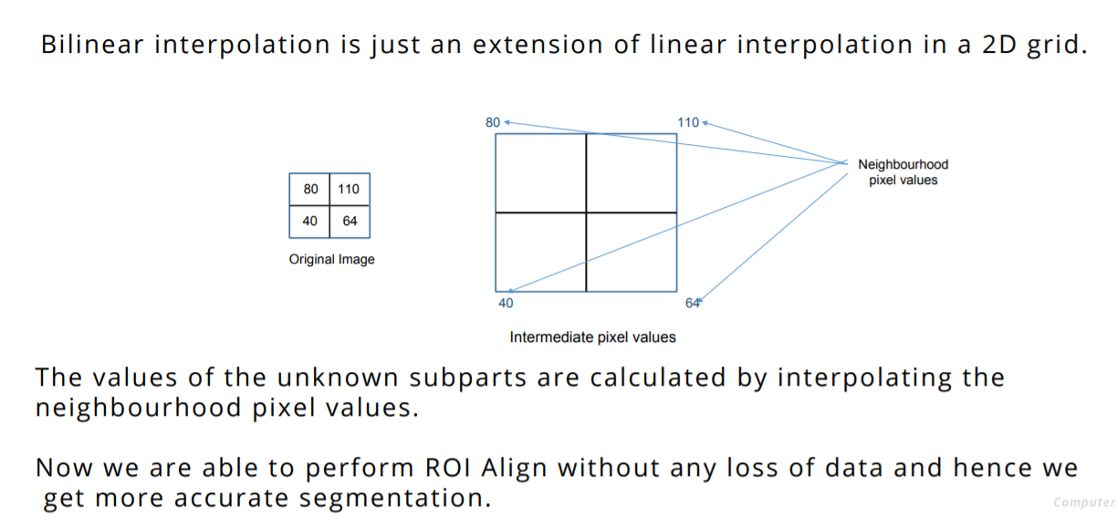
BILINEAR INTERPOLATION

Slide 9
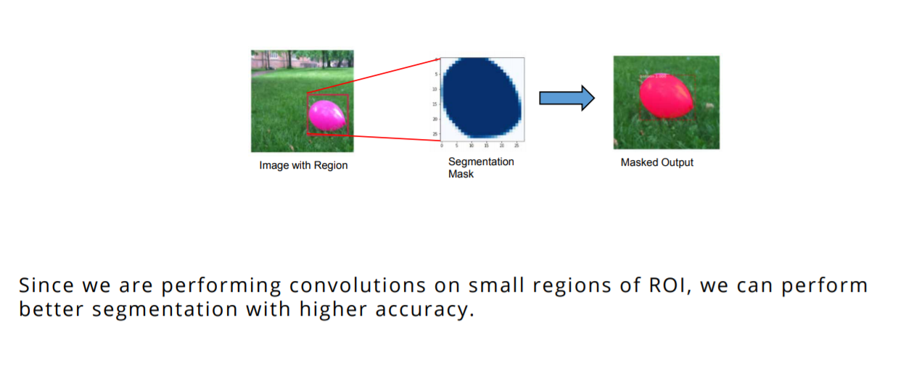
Mask Layer Output

Slide 10
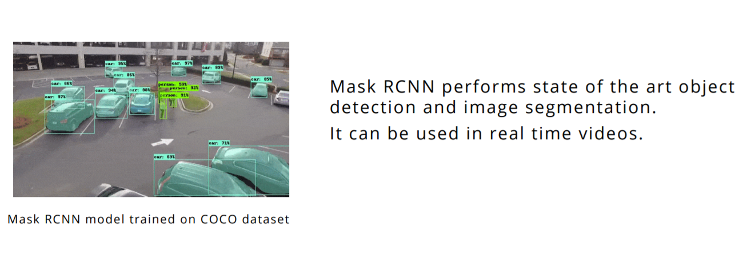
Final Output

